Slide 1
The Power of “I Can”: A Survivor and Therapist’s Guide to Neuroplasticity in Chronic ABI Recovery
2026 BIAK Brain Injury Summit
Allison Ferguson, MS, SLP Christine Szesny, PT, DPT Karl Mingus, ABI survivor
March 6, 2026

Slide 2
Allison Ferguson
About Us…
Christine Szesny
Physical therapist
UK alum PT for 11 years
Neuro Nerd
Bleed Blue
I have a goal to run the NYC Marathon before I turn 40
#1 fan for SLPs (and OTs too!)
Disclosures
Financial: None
Non-ﬁnancial: None
Speech Pathologist, Owner at Blossom Neuro Speech & Wellness
UK alum SLP for ~9 years
Pure Barre teacher
Love Your Brain Yoga for healthcare professionals
Book lover
Never met a dog she didn’t like
Disclosures
Financial: Co-owner of Blossom Neuro Speech & Wellness
Non-ﬁnancial: None

Slide 3
Objectives
1
2
3
4
5
Define neuroplasticity as it relates to ABI (acquired brain injury)
Identify timeline variations in chronic condition recovery
Identify how terminology used to discuss progress impacts survivor wellbeing
Understand emotional challenges of living with a chronic condition
Identify person-centered
outcome measures & treatments

Slide 4
Quotes from actual clients/care partners:
“They told me after a year I couldn’t get any better”
“The speech therapist said my aphasia won’t get better…I just have to live with it”
“He’s just lazy”
“I was in therapy for months and never learned neuroplasticity”
“Therapy was a waste of time”
“Is this ever going to getter better?”
“I just want to be normal again.”
“It [previous therapy] made me feel stupid”
“They told me I would never be able to drive again” (also insert “walk again” “use this hand again” “go back to work”, etc)

Slide 5
MYTH
FACT
Clients can continue to improve years after their injury, there is no ‘magic number’
After 1-2 years, a client with ABI has reached maximum potential and ‘won't’ get better”

Slide 6
A note on progressive diagnoses…
“Disorders of downward progression”
PPA, dementia processes, ALS, etc.
Encourage physical activity & social engagement
Care partner support is key
Modify their physical environment
Communication is still possible-support it
AAC is still feasible
Value the skills that remain
Balance honesty and hope
Holland, A. L. (2007).

Slide 7
What is neuroplasticity?
1
“The brain has an extraordinary a
capacity to adapt and reorganize following injury,
process driven by neural plasticity. This plasticity is central not only to learning new behaviours but also to recovering lost functions after brain damage.”
“Even in the absence of formal rehabilitation, brain damage prompts individuals to
develop
compensatory behaviours—self-taught strategies
to navigate daily activities
despite lost function”
“When occurs, it leads to changes in the brain's structure and function,
new learning
promoting neural growth and reorganisation”
Kleim,J. & Jones,T. (2008). Principles of Experience-Dependent Neural Plasticity: Implications for Rehabilitation After Brain Damage

Slide 8
Ten Principles of Neuroplasticity
Use it or lose it
Use it and improve it
Specificity (evidence-based exercises)
Salience (task should be meaningful)
Transference (skills may generalize to other areas)
Interference
Time
Age
Repetition (practice makes permanence)
Intensity
Kleim,J. & Jones,T. (2008).

Slide 9
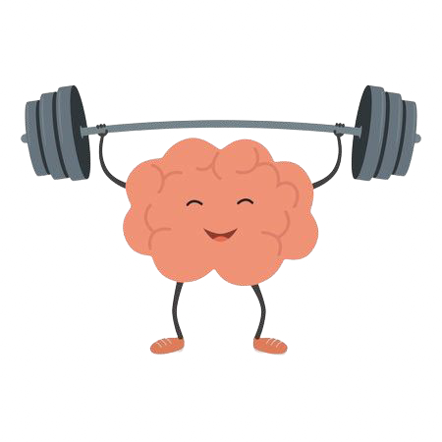

In other words…
Time + Repeated practice +
Personally meaningful activities = Brain change and progress
*It is our job to educate clients & families on neuroplasticity, using words and examples everyone understands*

Slide 10
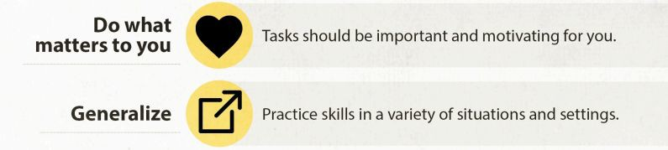
therapyinsights.com

Slide 11


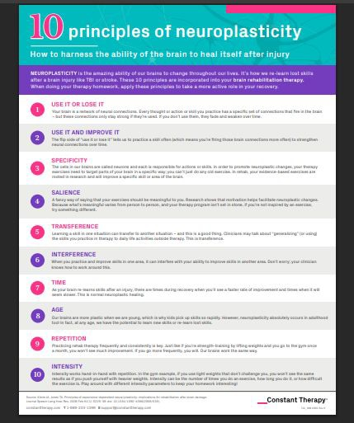
Free resource alert!
https://constanttherapyhealth.com/wp-content/uploads/2020/03/10-Principles-of-Neuroplasticity.pdf

Slide 12

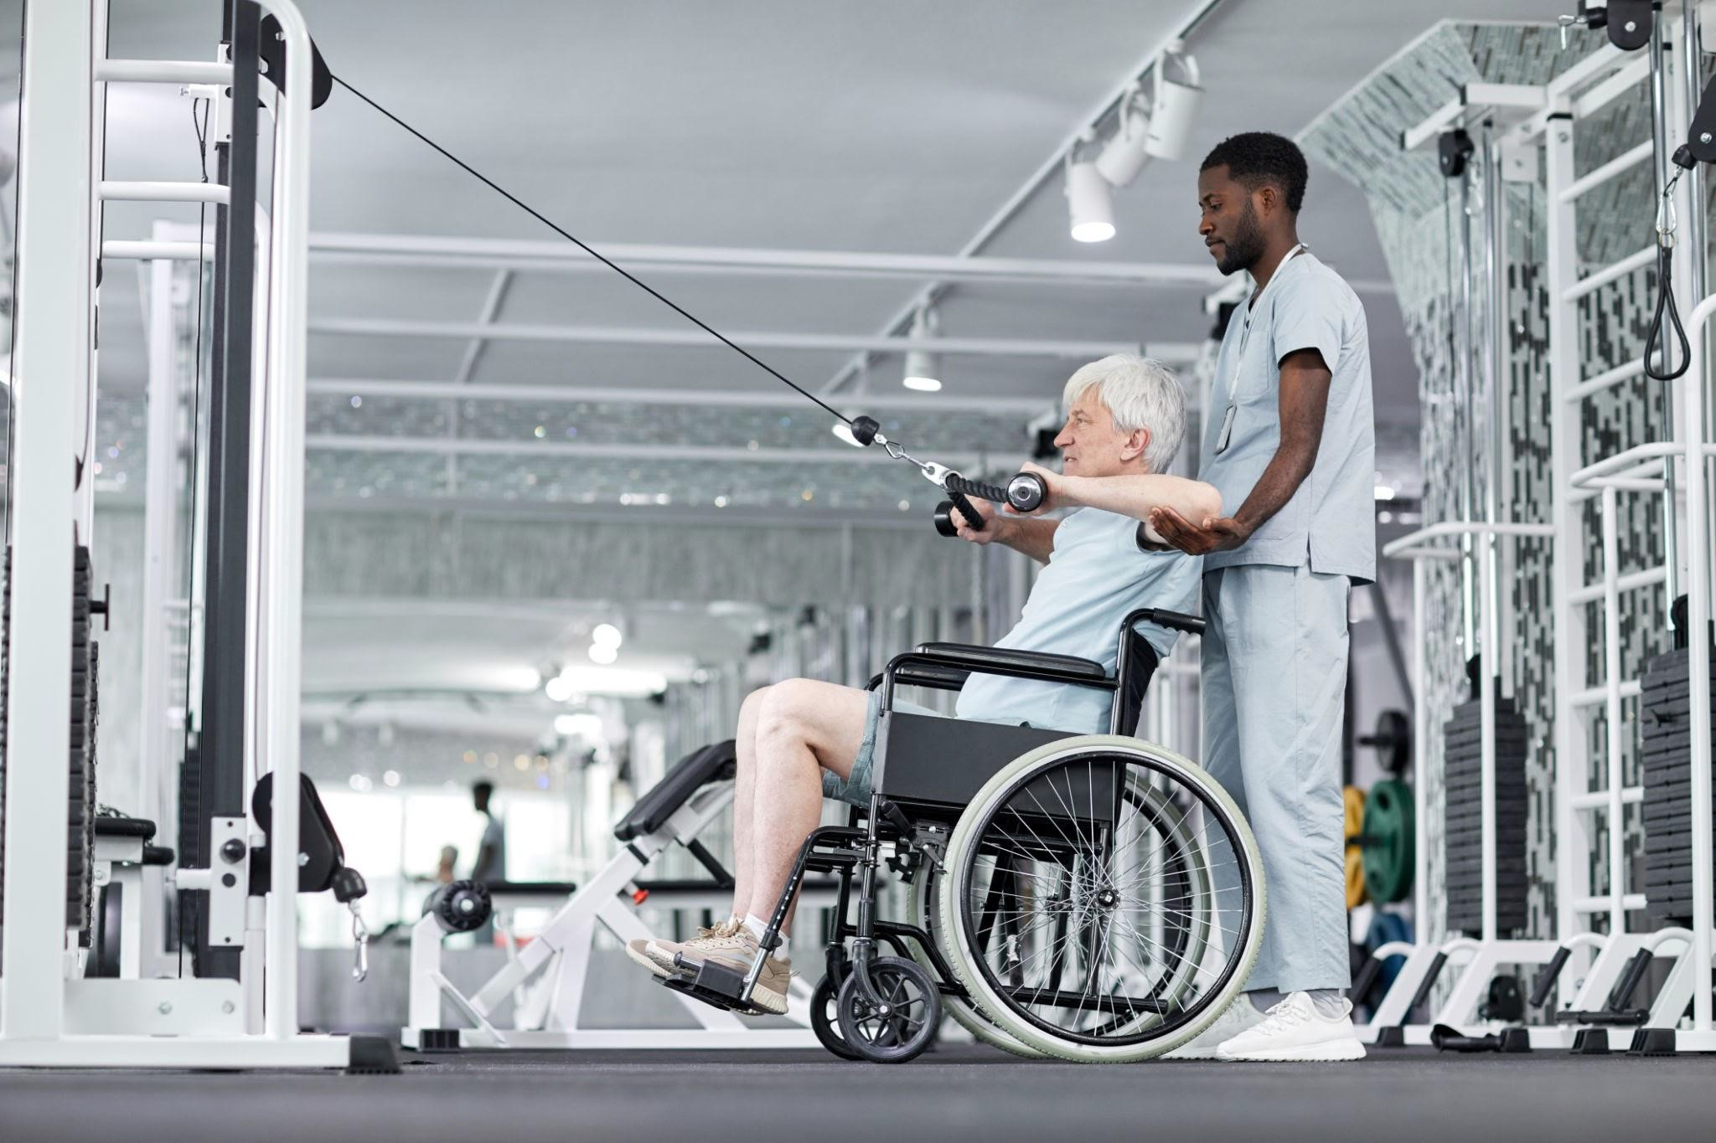

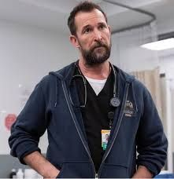
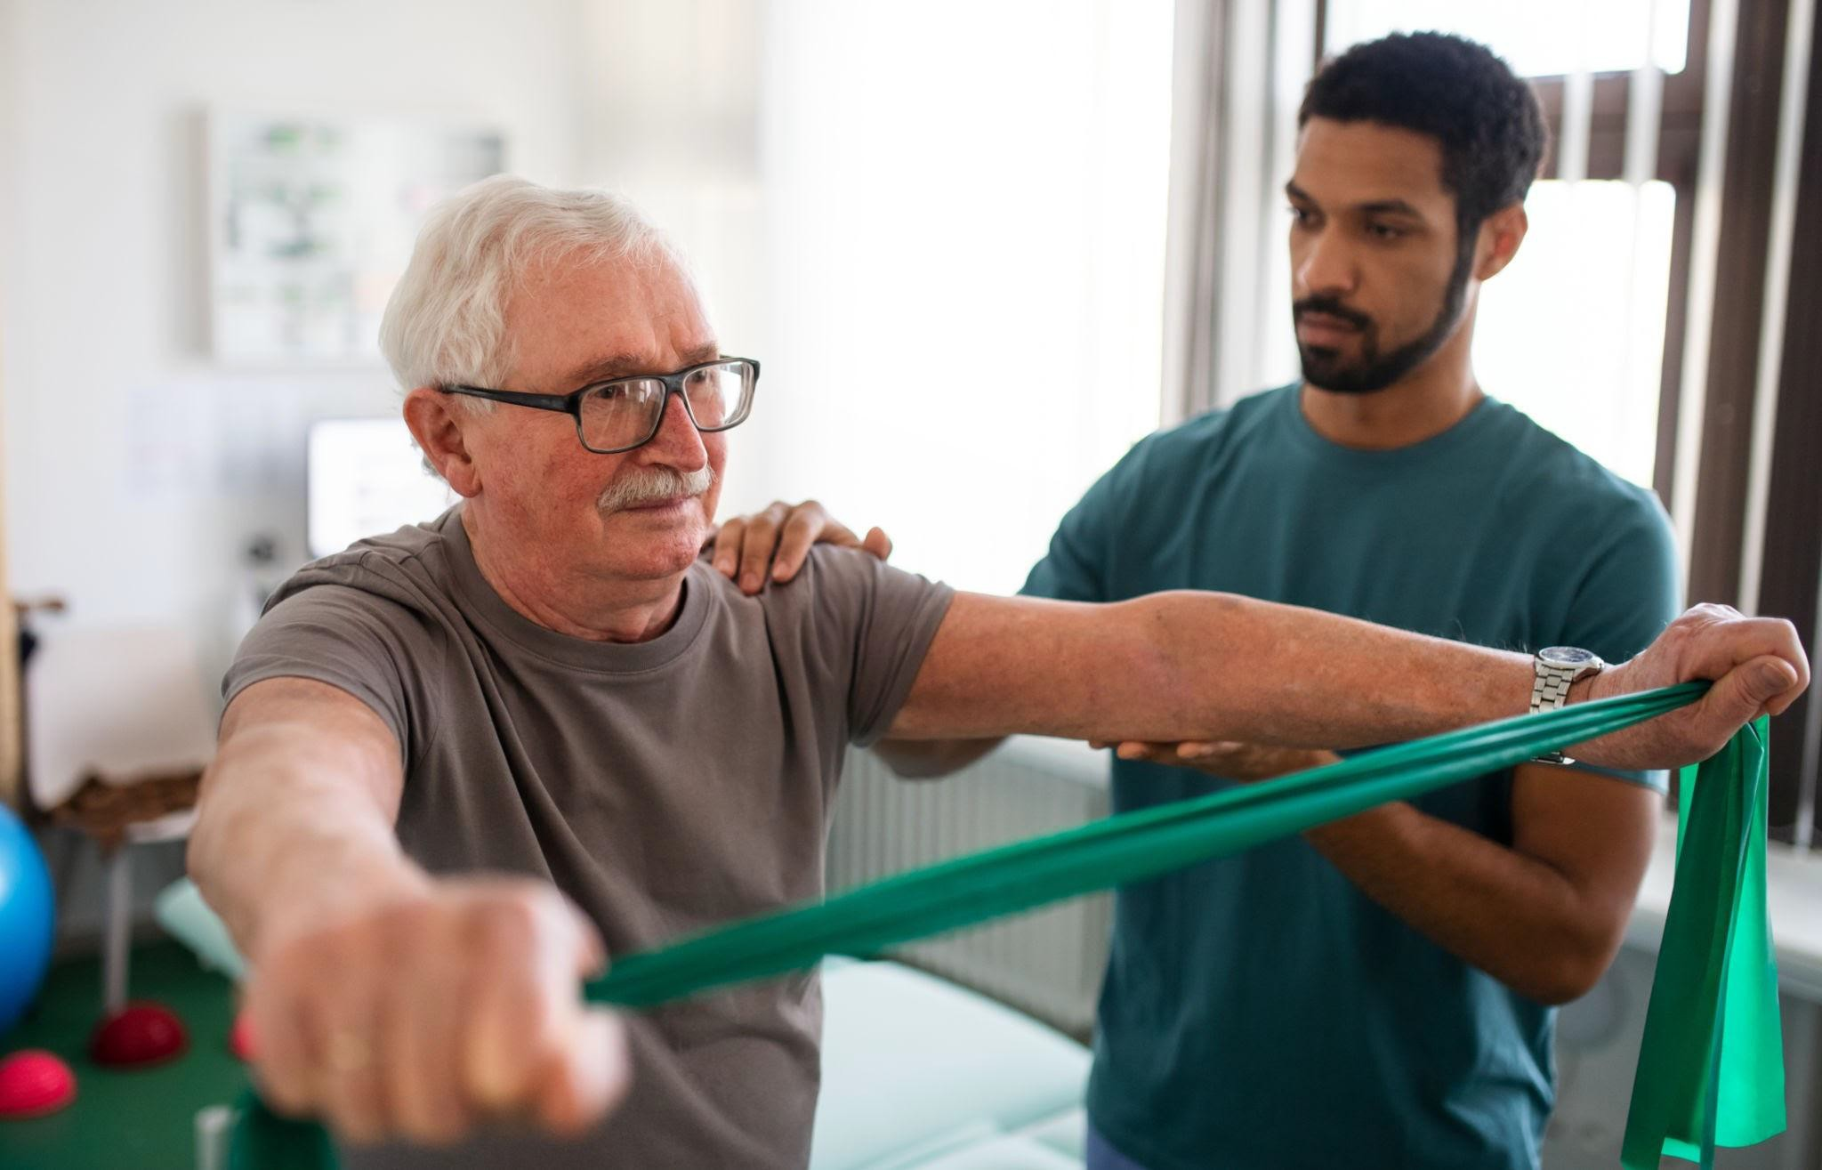

Stereotypical recovery timeline
2
Inpatient rehab
Home health
Acute care
ER/trauma center
*Many mild injuries aren’t addressed until the outpatient level
Outpatient/school therapy
Discharge: “as good as you’re gonna get”

Slide 13
Actual recovery timeline
“There is also a common myth that recovery from brain injury plateaus at 2 years after the initial injury. However, it was been well-documented that long-term functional gains can be acquired if the patient receives intensive
neurorehabilitation, even multiple years after the onset of ABI, especially with an emphasis on compensation training”
Johnson et. al, 2022
*A note on therapy plateau and necessary therapy breaks/episodic care

Slide 14
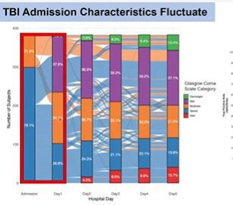
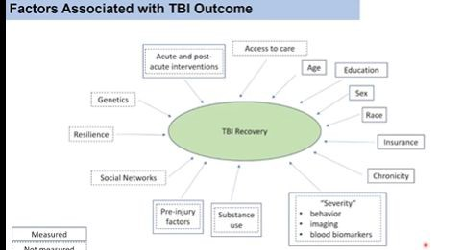
Presentation to ER or trauma center may or may not be indicative of long term progress…many factors are involved
Bodien, Y 2026

Slide 15
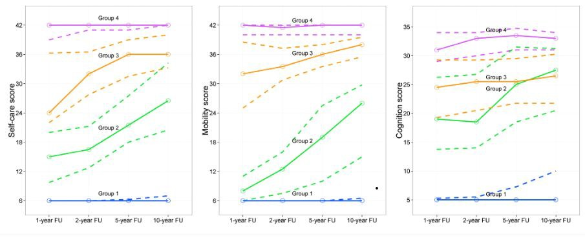
“Recovery can continue up to at least 10 years post TBI…recovery of independence after severe TBI is not just possible, but likely”
Hammond et al. J Neurotrauma, 2019; Bodien, Y 2026

Slide 16
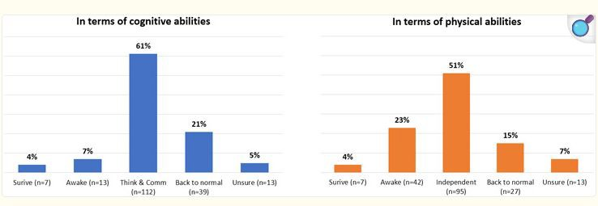
“Looking at 6 months or so from now, how
much better does your loved one need to get
that they would say that ‘all of this medical
care was worth going through’?
“As long as he/she can think and communicate, even if it is not the way he/she used to be”
“As long as he/she can walk, toilet and feed him/herself independently - without needing
help”
Voumard et. al 2021

Slide 17
Assessment/treatment
3
Impact on life participation and meaningful independence should be considered more
than a standardized test score
SLPs need to talk about improvements in terms of everyday life. This matters more than any test score improvement (Smith, et al., 2018)
SLPs need to focus intervention on relevant participation situations for the individual (Yorkston, Baylor, & Britton, 2017)
Treatments provided in real-life context have more beneficial outcome (Bogner, et al., 2019)
Incorporate goals from the interdisciplinary team into your treatment (as long as appropriate and you feel comfortable doing so)
Be thoughtful and planful with your interventions–every day of treatment matters to support return to improved independent function
●●

Slide 18
A Holistic Case History
Home, Job, Family, Friends, Pets, Community, Interests, Hobbies, Likes/Dislikes, Sleep, Hydration, Diet, Movement, Medications,
Vision, Hearing, Pain, Anxiety, Depression, Supports, Symptoms Post injury
Environmental Factors, PreInjury

Slide 19
All
Cognition, communication, social participation
Adult and pediatric
Multiple languages
T-scores for some scales
free!
Neuro QOL scales
Patient Specific Functional Scale
Client ranks performance on scale of 1-10
MDC/MCID scores
Can be used to set goals during first session
Communicative Participation Item Bank
10 items-measures communication across meaningful activities
Adult
T-scores
Multifactorial Memory Questionnaire
Memory performance across daily tasks
Also scales for feelings about memory & use of strategies
T-scores
Multiple languages
Caregiver report
Measures QOL, communicative participation, and multi-modal communication of clients and caregivers post stroke
Carer COAST
Communication Confidence Rating Scale (CCRSA)
10 items
Adults with aphasia
Measures confidence across meaningful communication domains

Slide 20
Executive Function Inventories
Child, teen, & adult scales (CHEXI, TEXI, & ADEXI)
A parent or care partner can fill out
No normed data yet
All
free!
Pediatric or very involved diagnoses
Measures early stages of communication
Can be used to educate families and set goals
Communication Matrix
“Brain fog” populations
Adult focused-several areas of fatigue
Cutoff scores
Mental Fatigue Scale
Measures feeling, acceptance, communication with others
Can rank speech among “other worries”
Request access from the library (research article)
Dysarthria Impact Profile
Eating Assessment Tool
Dysphagia; adult focused
Cutoff scores
Can be used across multiple settings
(EAT-10)

Slide 21
Activities-specific Balance
Measures fear of falling and confidence with performing daily activities
Can be self administered or administered by an interviewer
A score of less than or equal 49% indicates a falls risk in individuals with stroke
Confidence (ABC) Scale
Patient Specific Functional Scale
Client ranks performance on scale of 1-10
MDC/MCID scores
Can be used to set goals during first session
Mayo-Portland Adaptability Inventory (MPAI)
Assists in the clinical evaluation of individuals during the postacute period following ABI
Can be completed by individual, the caregiver or the clinician
Zarit Caregiver Burden
Caregiver report
Short and long forms
Participation Objective, Participation Subjective (POPS)
Helps to identify what is or is not important to an individual in their daily living
Can assist with identifying personalized, patient specific goals

Slide 22
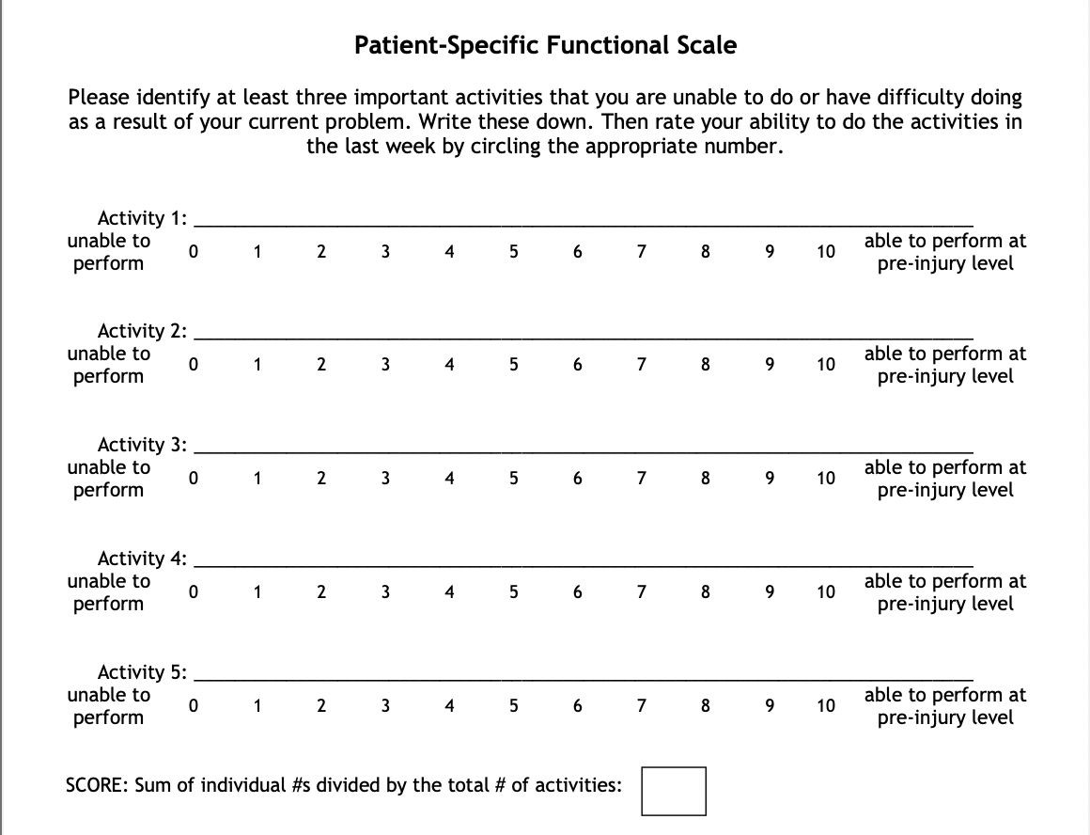


Minimum detectable change (90%CI) for average score = 2 points
Client example
Evaluation
Reading a Bible verse/passage
Self monitoring in conversation
__________
Minimum detectable change (90%CI) for single activity score = 3 points
Typing a paragraph (ex: emaiL)
Talking in a larger group/noisier environment
3.25

Slide 23
Minimum detectable change (90%CI) for average score = 2 points
Client example
Progress note
Reading a Bible verse/passage
Self monitoring in conversation
__________
Minimum detectable change (90%CI) for single activity score = 3 points
Typing a paragraph (ex: emaiL)
Talking in a larger group/noisier environment
6

Slide 24
Treatments & Strategies
Person-centered
Meaningful
Evidence-based

Slide 25
Instead of this…. | Try this!
“Client will recall 5 unrelated words” | “Client will recall sequence for activating hospital call button” or “Jill will recall first 6 steps of teaching a sun salutation” or “Client will independently navigate calendar app on phone”
Memorizing word lists so client can remember a grocery/errands list | Teach metacognitive strategy of writing items down as soon as they think of them, or practice using internal rehearsal until they can write it down
Using box picture cards for naming | Name photos from their smartphone, items in their room, Google map places, team logos
Workbook auditory comp passages or y/n questions | TED talks, podcasts, news clips, conversation supports
Generic workbooks for adolescent language | Use their homework/schoolwork or have them read & teach you the rules to an age-appropriate game
“Client will name X number of items in a concrete category” | “Using word finding strategies as indicated, client will name X number of family members/preferred activities/desired restaurant items” etc.

Slide 26
Instead of this…. | Try this!
Dysarthria worksheets and workbook pages or pre-made pediatric articulation pages | Create a list most meaningful words/phrases and practice with high repetitions (remember-neuroplasticity!)
Reading comprehension passages from workbooks | TalkPath News, Chat GPT, or client’s favorite reading material from home
Sudoku puzzle for problem solving | Problem solving for any meaningful task determined in case history/interview
Playing games for adult cognitive therapy (unless they have a personal goal of games) | Organize email inbox, develop system for checking & sorting mail, wheelchair transfer sequence, cooking tasks, sending cards to friends, accessing phone apps
Sequencing worksheets | Goal Plan Do Review for a meaningful task
“Client will perform 10 effortful swallow exercises” | Review neuroplasticity principles to determine # of reps needed to actually tax the system

Slide 27
Response Elaboration Training
Evidenced-
Multiple Oral Re-reading
Use song lyrics, favorite story, Bible passage instead of workbooks or tongue twisters
based!
Spaced Retrieval
Truly anything they want to recall
Great for
sequencing technology
Use candid family photos instead of generic action photos
Semantic Features Analysis
Copy and Recall Treatment (CART)
Action Observation Treatment
Use a video clip database (ie:: Pixabay Videos, Pexel Videos) to find relevant actions
Use family names, team names, address
Texting option!
Use items in their room
Family members

Slide 28
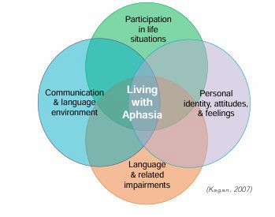
A-FROM model and the Life Participation Approach to Aphasia

Slide 29
PTs: Whats in your tool kit?
First and foremost–always respect the autonomy of any and every patient.
Utilize a Multidisciplinary Approach | Integrated care is paramount for optimal recovery
Patient Centered Adaptations | Focus on functional tasks that are relevant to the patient’s daily life–ie if they are peforming seated reaching to address trunk control have them reaching for something meaningful (a coffee cup if they’re a coffee fanatic, a baseball if all they do is talk about the Yankees, etc)
Task Oriented Training | Emphasize repetition of real world activities to improve motor control and function
Family/Caregiver Training | Engaging loved ones in a person’s brain injury recovery including goal setting and preparing them for the recovery journey will allow the caregiver to best support the patient optimizing outcomes

Slide 30
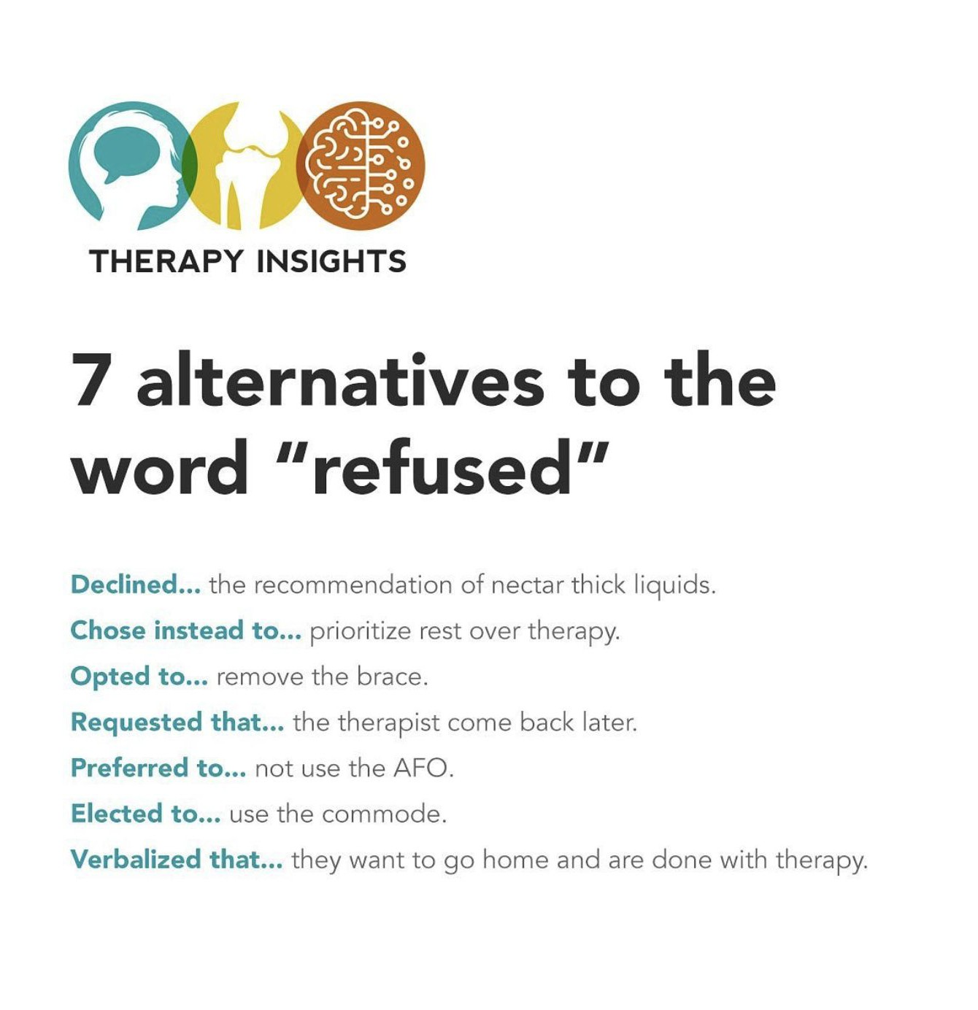
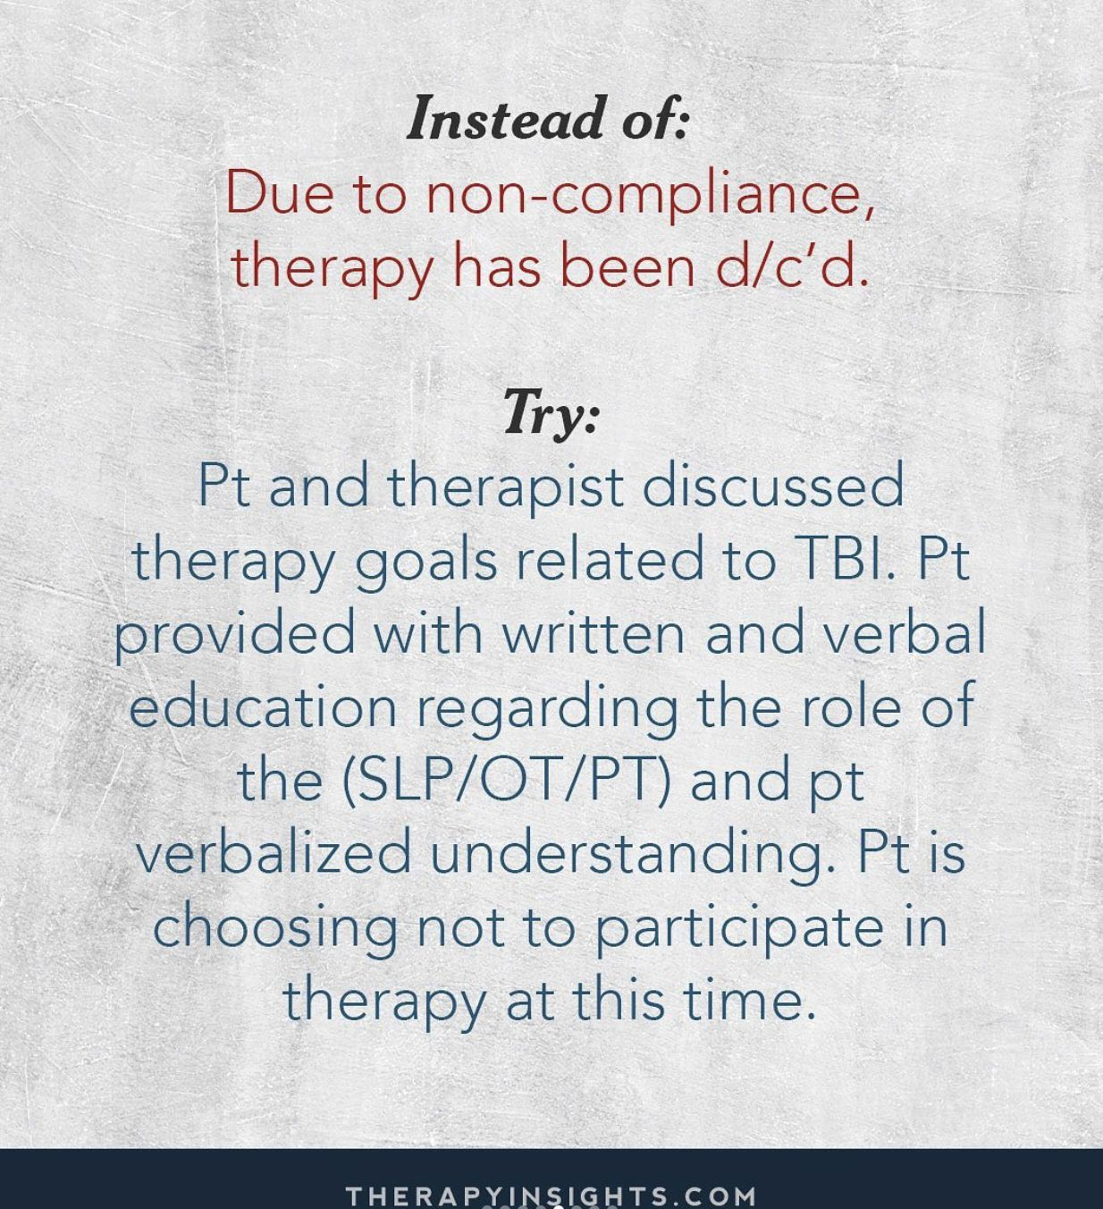

Slide 31
Your words matter
4
Clients will remember the words we say long after discharge
Avoid “good job”...be specific
Specific feedback promotes neuroplasticity
“I know you know”
Unconditional positive regard
Non-judgmental stance
Not “good or bad”
Presume competence but also consider most patients are not practitioners–provide explanations at an appropriate level
REMEMBER:
THE IMPORTANCE AND POWER OF LISTENING

Slide 32
Psychosocial Impacts
5
An ABI does change identity and one’s sense of self
An ABI happens to the whole family
Care partner training for aphasia (aphasia.ca)
Empower the loved ones to empower clients!
Caregiver training sessions
Skilled, billable, little prep time

Slide 33
Mental Health & Aphasia
Clients with aphasia are more than 7x likely to experience post-stroke depression
Depression diagnosis for persons with aphasia (PWA)
3 months post stroke: 70%
1 year post stroke: 62%
National Aphasia Association Survey:
90% felt socially isolated
70% felt others avoided contact with them
Aphasia severity is the stroke-related factor that predicts how much a person’s social network will decline (6 months post stroke)
Thompson & Reed 2024; Carr 2011; Zanella 2020 & 2022; Hilari & Northcott, 2016; Northcott et al., 2016; Davidson et al., 2008

Slide 34
Those statistics combined what we know but maybe aren’t sharing about neuroplasticity…imagine the impact of hearing “only a year or two to get better”
Versus…
Figuring out what a client’s meaningful goals are and promoting neuroplasticity to make progress, not perfection

Slide 35
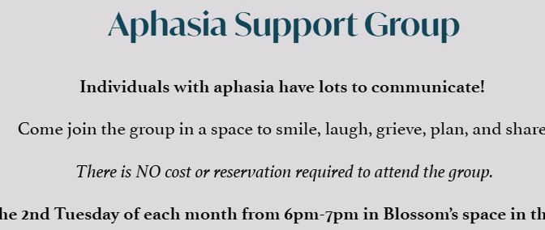
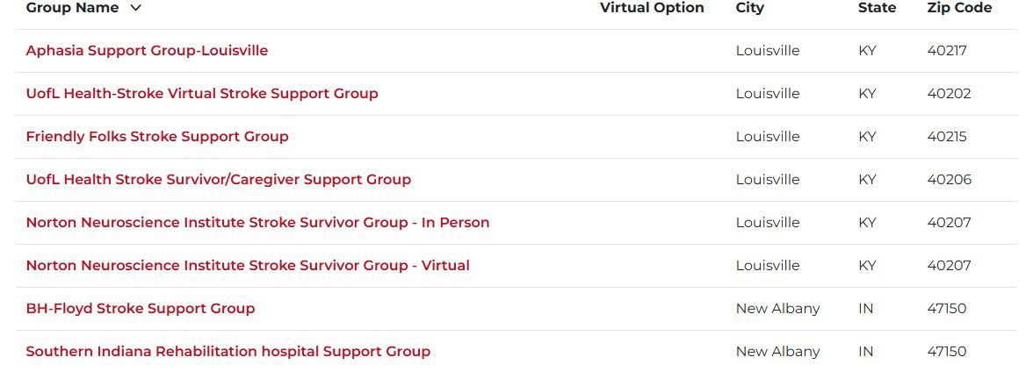
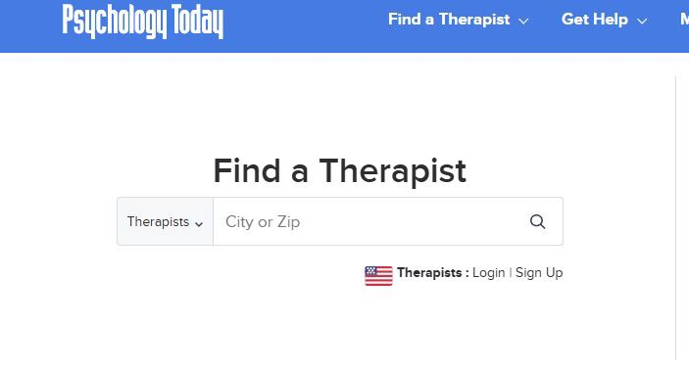

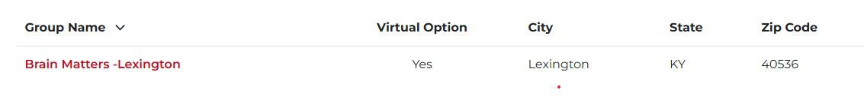

Slide 36
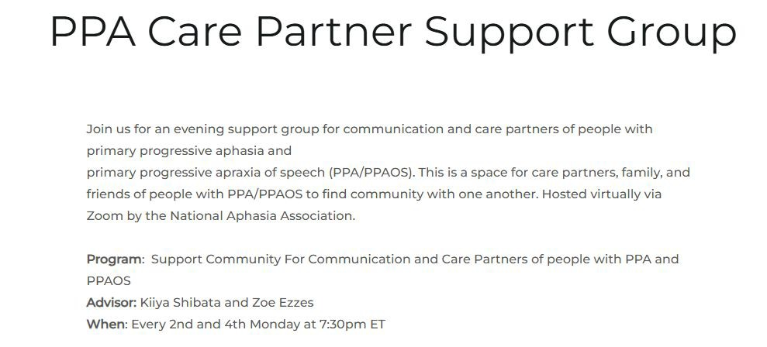
Virtual!
National Aphasia Association website

Slide 37
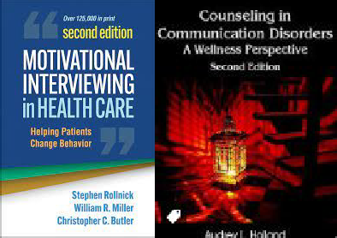





Favorite Education Resources
Books/Articles
Counseling in Communication Disorders: Nelson & Holland
Motivational Interviewing in Healthcare: Stephen Rollnick
Rights Come to Mind: Joseph Fins
Transforming Cognitive Rehabilitation: Solberg & Turkstra
Optimizing Cognitive Rehabilitation: Solberg & Turkstra
INCOG 2.0 articles
brainandcommunication.ca
What
else?!
@therapyinsights @neuro.connections @neurospeechservices @the.neuro.slp @speechuncensored @unlearnwithme.theslp @ptsd.slp @deseles_phd

Slide 38






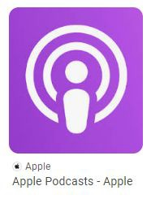
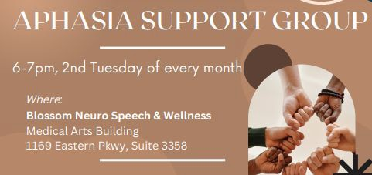
Favorite Resources
Meditation & Mindfulness
10% Happier
Insight Timer
Headspace
https://www.loveyourbrain.co m/resources
Coherent Breathing Classes: ask us for more info!

Slide 39
Christine & Allison aren’t the experts, however. So they brought someone that is….

Slide 40

References
Holland, A. L. (2007). Counseling in communication disorders: A wellness perspective. Plural Publishing Inc..
Kleim,J. & Jones,T. (2008). Principles of Experience-Dependent Neural Plasticity: Implications for Rehabilitation After Brain Damage
https://constanttherapyhealth.com/wp-content/uploads/2020/03/10-Principles-of-Neuroplasticity.pdf
therapyinsights.com
Johnson SF, Klonoff PS, Perumparaichallai RK. Long-term neurorehabilitation outcomes of pediatric vs. adult onset acquired brain injury. Front Neurol. 2022 Dec 20;13:981991. doi: 10.3389/fneur.2022.981991. PMID: 36605786; PMCID: PMC9810073.
Hammond FM, Giacino JT, Nakase Richardson R, Sherer M, Zafonte RD, Whyte J, Arciniegas DB, Tang X. Disorders of Consciousness due to Traumatic Brain Injury: Functional Status Ten Years Post-Injury. J Neurotrauma. 2019 Apr 1;36(7):1136-1146. doi: 10.1089/neu.2018.5954. Epub 2018 Oct 19. PMID: 30226400.
Bodein, Yelena. Long term outcome after severe traumatic brain injury. 5th Biannual International Cognitive Communication Disorders Conference. Jan 16, 2026.
Rutz Voumard R, Kiker WA, Dugger KM, Engelberg RA, Borasio GD, Curtis JR, Jox RJ, Creutzfeldt CJ. Adapting to a New Normal After Severe Acute Brain Injury: An Observational Cohort Using a Sequential Explanatory Design. Crit Care Med. 2021 Aug 1;49(8):1322-1332. doi: 10.1097/CCM.0000000000004947. PMID: 33730742; PMCID: PMC8282680.
Bogner et al., (2019) Contextualized treatment in traumatic brain injury rehabilitation: eﬀects on outcomes during the 1st year after discharge. Archives of Physical Medicine and Rehabilitation, 100(10), 1810-1817.

Slide 41

References
Yorkston, K., Baylor, C., & Britton, D. (2017) Speech vs speaking: The experiences of people with Parkinson’s Disease and implications for intervention. American Journal of Speech-Language Pathology, 26, 561-568.
Smith GE, Chandler M, Fields JA, Aakre J, Locke DEC. A Survey of Patient and Partner Outcome and Treatment Preferences in Mild Cognitive Impairment. J Alzheimers Dis. 2018;63(4):1459-1468. doi: 10.3233/JAD-171161. PMID: 29843239; PMCID: PMC6027859.
Kagan, A., Simmons-Mackie, N., Rowland, A., Huijbregts, M., Shumway, E., Mcewen, S., Threats, T., & Sharp, S. (2007). Counting what counts: A framework for capturing real-life outcomes of aphasia intervention. Aphasiology, 22(3), 258 280. https://doi.org/10.1080/02687030701282595
Zanella, C., Laures-Gore, J., Dotson, V., & Belagaje, S. (2022). Incidence of post-stroke depression symptoms and potential risk factors in adults with aphasia in a comprehensive stroke center, Topics in Stroke Rehabilitation, 30(5):448-458. https://doi.org/ 10.1080/10749357.2022.2070363
Zanella, C. (2020). The incidence of post-stroke depression in adults with aphasia in an acute care setting. Thesis, Georgia State University. 2-45. https://doi.org/10.57709/20347515
Carr, C. (2011).Understanding aphasia is the most important part of recovery.Brain & Life.https://www.brainandlife.org/articles/understanding-aphasia-is-crucial-to-recovery-for-patients-and-caregivers/.
Hilari, K. & Northcott, S. (2016). "Struggling to stay connected”: Comparing the social relationships of healthy older people and people with stroke and aphasia. Aphasiology, 31(6), 674-687. https://doi.org/10.1080/02687038.2016.1218436
Northcott, S., Marshall, J., & Hilari, K. (2016). What factors predict who will have a strong social network following a stroke? Journal of Speech, Language, and Hearing Research, 59(4), 772–783. https://doi.org/https://doi.org/10.1044/2016_jslhr-l-15-020

Slide 42
References
Davidson, B., Howe, T., Worrall, L., Hickson, L., & Togher, L., (2008). Social participation for older people with aphasia: the impact of communication disability on friendships. Topics in stroke rehabilitation, 15(4) 325
340.https://doi.org//10.1310/tsr1504-325
Thompson, Theresa & Reed, Allie. Tackling the Psychosocial Impacts of Aphasia: The SLPs Role. Lingraphica. Jan 11, 2024.

